Slide 1
Pre ML Concepts

Slide 2
Optimizing the Bias – Variance Tradeoff in Statistical Modeling
Till now, we have learned about the regression model is type of machine learning model.
Like f(x) = aX1+bX2+c so this is called linear regression bcz it’s degree 1 equation
If f(x) = aX1+bX^2 +c is degree 2 equation
In real scenario, linear regression will not fit every time, it’s not idle model to choose
Usually data is more complex, it’s not linearly related
In any case you want to use the regression, then you will increase the degree of equation. Means straight line will not fit in all the types of data so we are using polynomial function
As you increase the degree, you will cover all the data but on the opposite side complexity will also increase

Slide 3
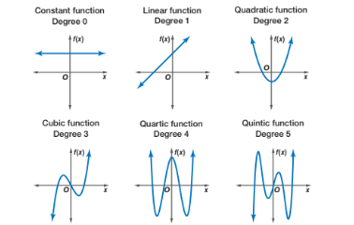
As we can see in graph the, as we increase the degree of function will cover the all data so more complex function will help to cover all the data
As we increase the complexity , lower the error will be as it captured all the data.
The goal of machine learning model to have train data and have machine learning model train on train data and now ML model take some test data and get the result. And this result is called Test output

Slide 4
Both the error called Training Error and Test Error. And both of these things are relevant for machine learning.
When you increase the complexity of the model, your model cover all the data points so your training error will reduce because the model is memorizing the stuff.
In degree 1 and 2 model will normalizing the data where in degree 10 model is memorizing the train data
When it comes to new data points, the model for which we increased the complexity very high, will have a higher variance (spread of the data)
and the model with lower degree or less complex have higher error rate.
As you increase the complexity of model, your model get improved on trainee error but it can worse on test error because of memorizing the stuff means I can see lots of error in my test data and error will be spread out
Means for some data point it’s less and for some data points it’s high.
So these types of error are not good which we saw in assumption of linear regression
It gives you Heteroscedasticity
In Summary, As we increase the complexity of model, my training error will decrease and my test error will increase and my variance will increase

Slide 5
Understanding train and test data
The train-test split is a technique for evaluating the performance of a machine learning algorithm. It can be used for classification or regression problems and can be used for any supervised learning algorithm
The procedure involves taking a dataset and dividing it into two subsets. The first subset is used to fit the model and is referred to as the training dataset. The second subset is not used to train the model; instead, the input element of the dataset is provided to the model, then predictions are made and compared to the expected values. This second dataset is referred to as the test dataset.
Train Dataset:- Used to fit the machine learning model.
Test Dataset:- Used to evaluate the fit machine learning model.
The objective is to estimate the performance of the machine learning model on new data: data not used to train the model. This is how we expect to use the model in practice. Namely, to fit it on available data with known inputs and outputs, then make predictions on new examples in the future where we do not have the expected output or target values.

Slide 6
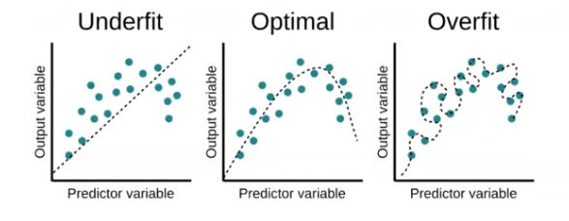
Understanding underfitting and overfitting
In machine learning and pattern recognition, there are many ways (an infinite number, really) of solving any one problem. Thus it is important to have an objective criterion for assessing the accuracy of candidate approaches and for selecting the right model for a data set at hand. We’ll discuss the concepts of under- and overfitting and how these phenomena are related to the statistical quantities bias and variance. Finally, we will discuss how these concepts can be applied to select a model that will accurately generalize to novel scenarios/data sets.
In overfitting data will be memorized and underfiting you use less complex model and optimal is more generalize function

Slide 7
Models of Regression

Slide 8
Summary
Assume we have data points of x and y and f(x) is my idle machine learning model
Also, f(x) does not cover all the data points, f(x) just cover the form of data
So we can write y = f(x) + e , where e is error (if f(x) cover e part as well then my function will overfit
I don’t know the form of f(x) so will try to find out g(x) and try to improve my g(x) equivalent to f(x)
g(x) looks like, g(x) = θ0+ θ1x + θ2x^2+…..+θdx^d (based on degree it will take different form)
Now will compare my g(x) to my f(x)
This is for one data sample so now using E[G(X)] because it will cover factor e as well (means taking multiple dataset)
Now we compared E[g(x)] with f(x)

Slide 9
Compared in bias and variance. Bias means diff of E[g(x)] and f(x)
Variance does not depend on f(x). Variance just cover the spread of data. How varied value coming in g(x)
Our model want lower bias and lower variance
Total Error = Variance + Bias + Irreducible Error (that can not be reduce)
Irreducible error is the error that remains even with a perfect model, representing the fundamental limitations of predicting the target variable due to inherent randomness or unobserved factors.
Our goal is to reduce bias and variance of machine learning model
When you say trade off, complexity increase your bias will decrease (bcz diff in E[g(x)] and f(x) decrease) means it’s trying to cover all the data points and variance will increase (because of complexity your model will vary a lot) and that’s why variance will increase
That’s why we use the tem trade off
Means we have to take the middle point

